Slide 1
Oregon Health Plan (OHP)
Dawn Mautner, MD, MS
Medicaid Medical Director
Shared with:
Oregon Primary Care Association Polysubstance Use Disorders Work Group
Wednesday, May 28, 2025

Slide 2
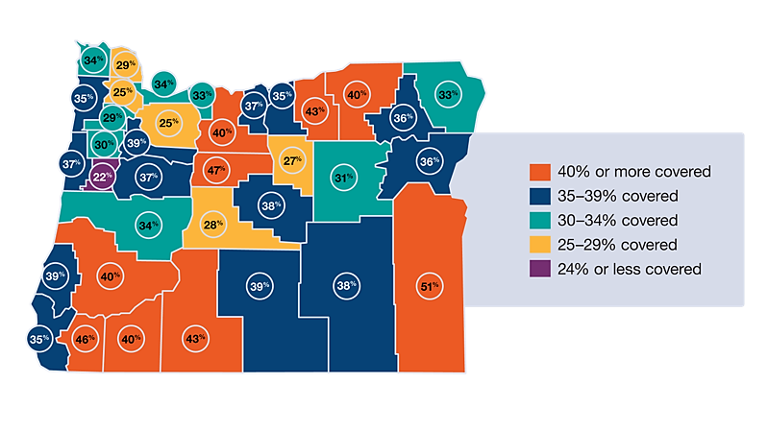
Oregon Health Plan (OHP / Medicaid)
Oregon has 1.4 million Medicaid members
1 in 3 people in Oregon are covered by Medicaid
57% of children in Oregon are covered by Medicaid
Half of births in the state are covered by Medicaid
2 out of every 3 nursing home residents rely on Medicaid
Counties in rural areas typically have higher Medicaid enrollment

Slide 3
Oregon Health Plan (OHP / Medicaid)
Oregon’s post-COVID Medicaid renewals rate: 83%; top three in the nation
Children who qualify for OHP can now be covered from birth to age six.
Adults may now be able to keep OHP benefits for two years, instead of one.
A record 97 percent of Oregonians have health coverage, the highest recorded insured rate in state history.
OHP Bridge: more than 26,000 covered, Healthier Oregon: more than 95,000 covered
Health Insurance Coverage in Oregon | 2017 | 2023
Statewide | 93.8% | 97.0%
American Indian or Alaska Native | 89.7% | 96.3%
Black or African American | 91.4% | 93.9%
Latinx | 84.6% | 92.3%
19- to 34-year-olds | 88.0% | 94.0%
Notes:
We note that federal activity may impact some of OHP’s currently waivered elements. We continue to monitor closely. Links to most current communications from OHA are included on a later slide.

Slide 4




OHP Clinical Connections
A bidirectional webinar series for delivering OHP updates and receiving provider feedback
2025 dates: quarterly, third Tuesdays, 1-2 p.m.
June 17
September 16
December 16
June 17 agenda topics:
HRSN Medically Tailored Meals
EPSDT benefit
BUP
The team:
  Dr. Meg Cary
  Dr. Ahmed Farag
  Dr. Dawn Mautner
  In collaboration with:
    Rafia Razzaque
    Diane Quiring
    Dan Cox
    Dra. Andrea Lara
    Satyasandipani Pradhan
Visit the OHP Clinical Connections website
Contact: dan.cox@oha.oregon.gov
Notes:
OHP’s Medical Leadership Team, consisting of OHP’s three medical directors, will begin to host quarterly webinars to connect with clinicians and medical leaders across the state. We will deliver state OHP updates and open dialogue with OHP providers, especially those who serve FFS or Open Card members. Please advise your teams, and ask that they contact us if they are interested in collaborating.

Slide 5

Health-Related Social Needs (HRSN)
Health-Related Social Needs (HRSNs) are social and economic needs that affect people’s ability to stay healthy and well. Eligible OHP members may get these services meant to help improve their health outcomes.
HRSN Benefits include:
Housing Supports
Nutrition-Related Supports
Outreach & Engagement Services
Resources:
1115 Waiver HRSN Webpage
HRSN Housing and Nutrition webpages, which include: eligibility descriptions, factsheets, HRSN request forms & links to CCO HRSN request forms
Notes:
Eligibility

Slide 6

Oregon Health Plan (OHP / Medicaid)
Where to Learn More, Stay Informed, & Engage to Impact Health Policy:
Subscribe to Oregon Health News (general audience)
Subscribe to Provider Matters (provider-focused newsletter)
OHA’s web page to monitor federal changes
OHP Clinical Connections web page – for clinicians
OHA’s social media channels:
  LinkedIn
  Facebook
  Facebook en Español
  Instagram
HERC
RACs

Slide 7
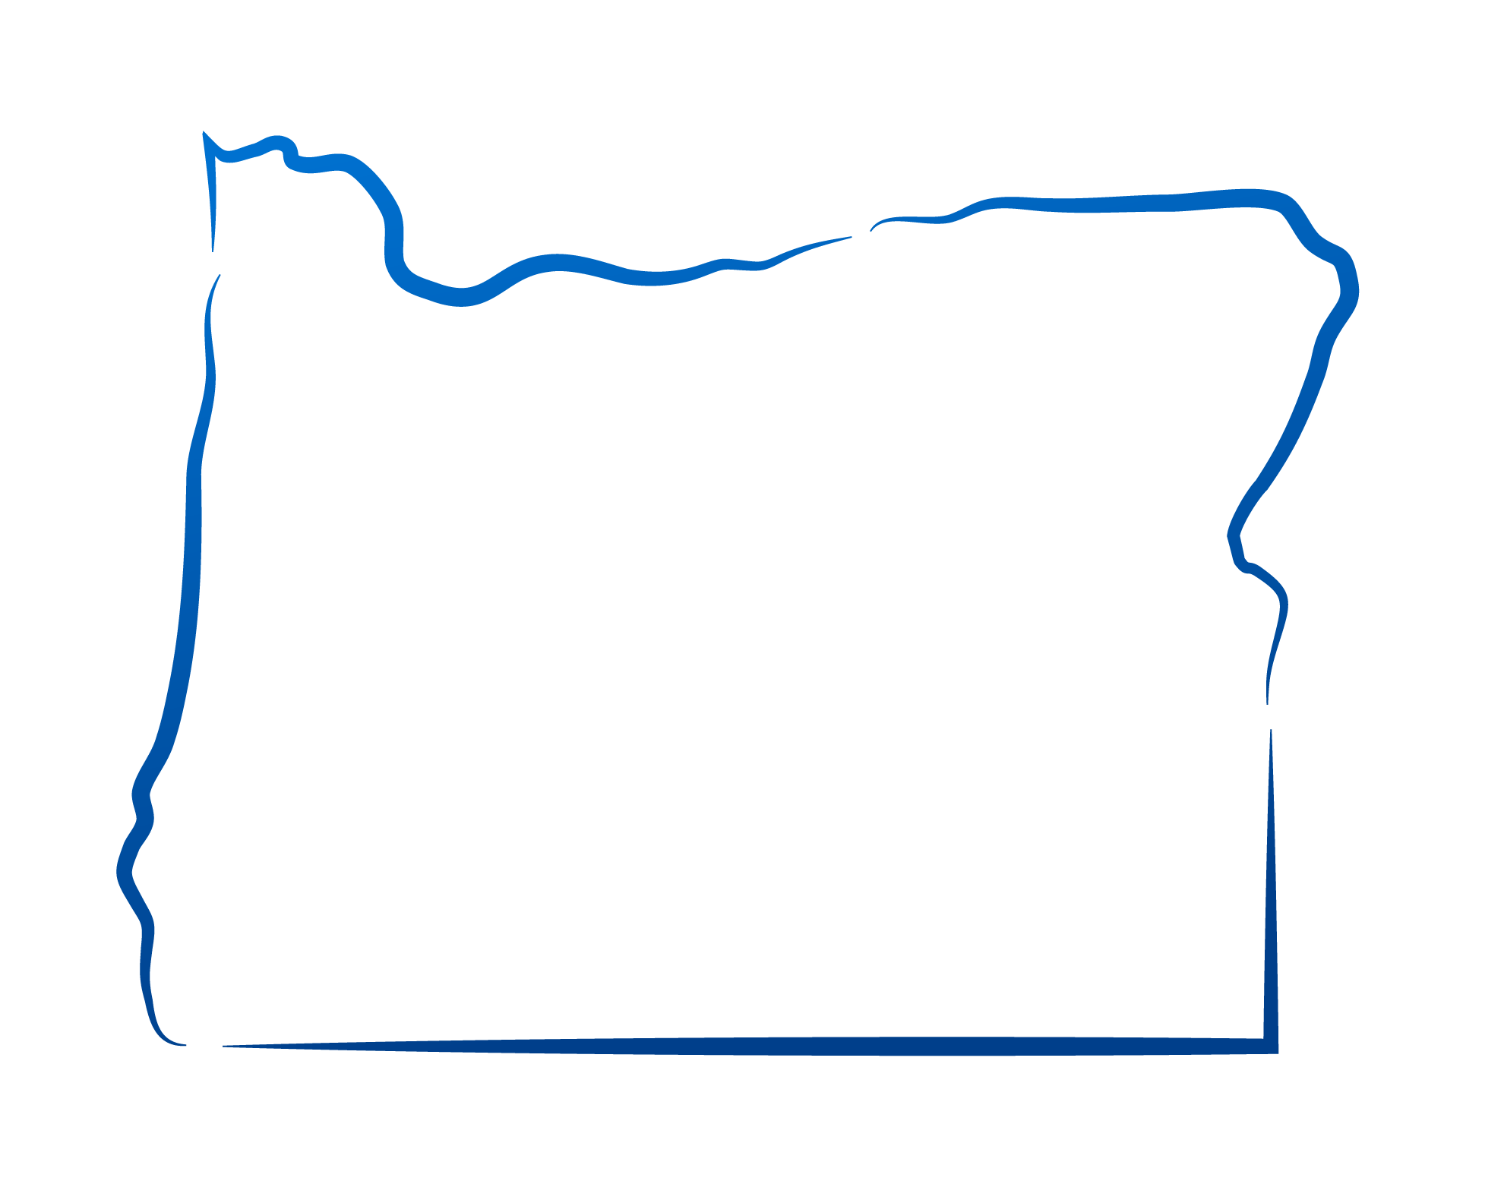

Thank you!

